Slide 1


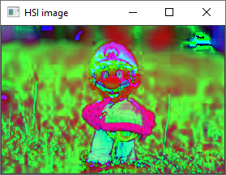

Slide 2
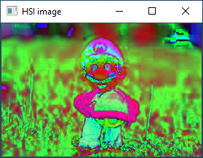


Slide 3
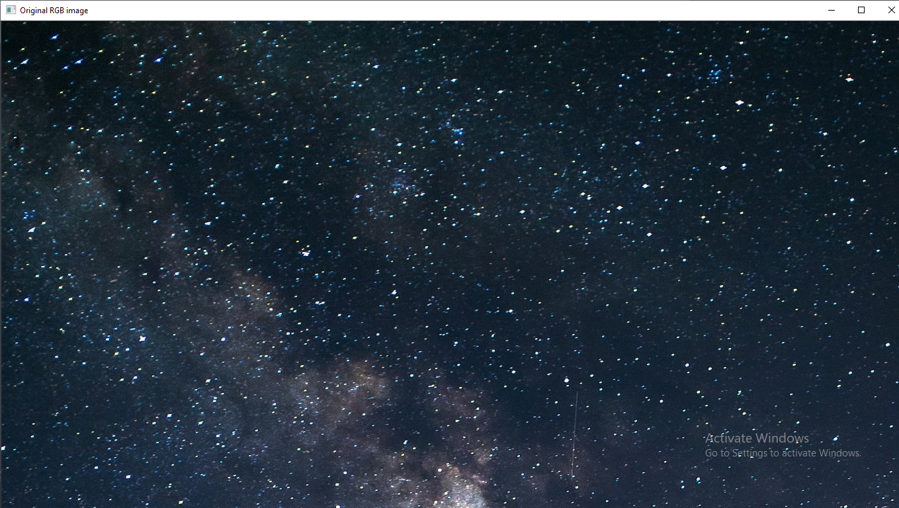

Slide 4
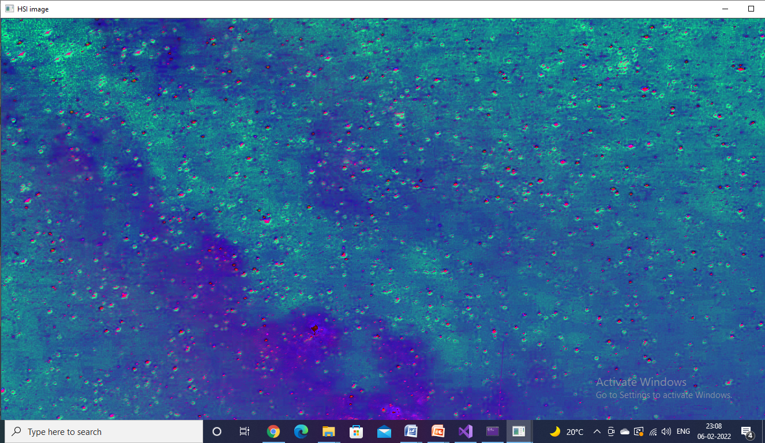

Slide 5
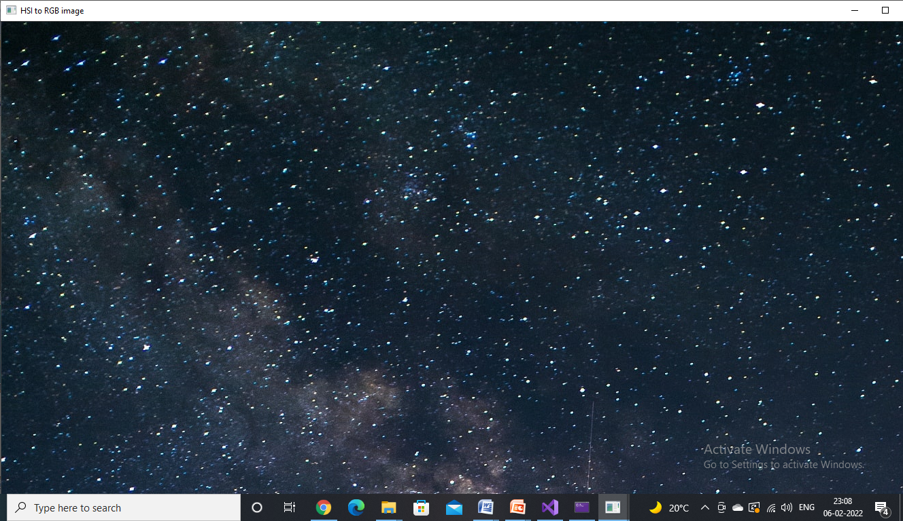

Slide 6
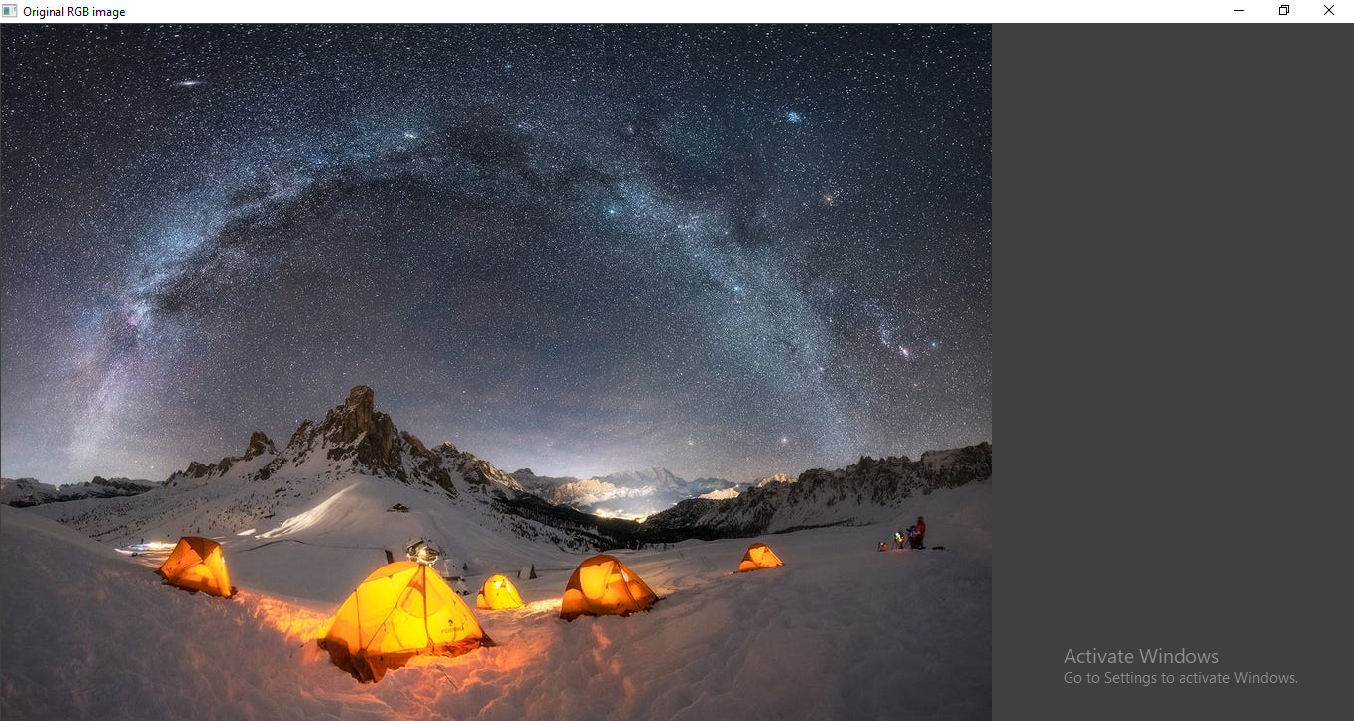

Slide 7
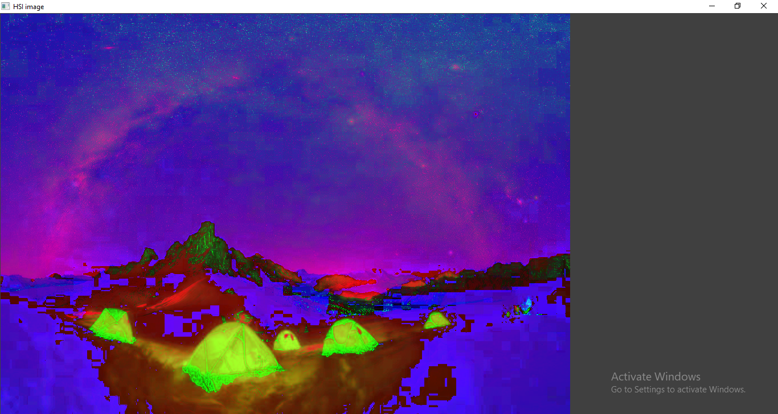

Slide 8
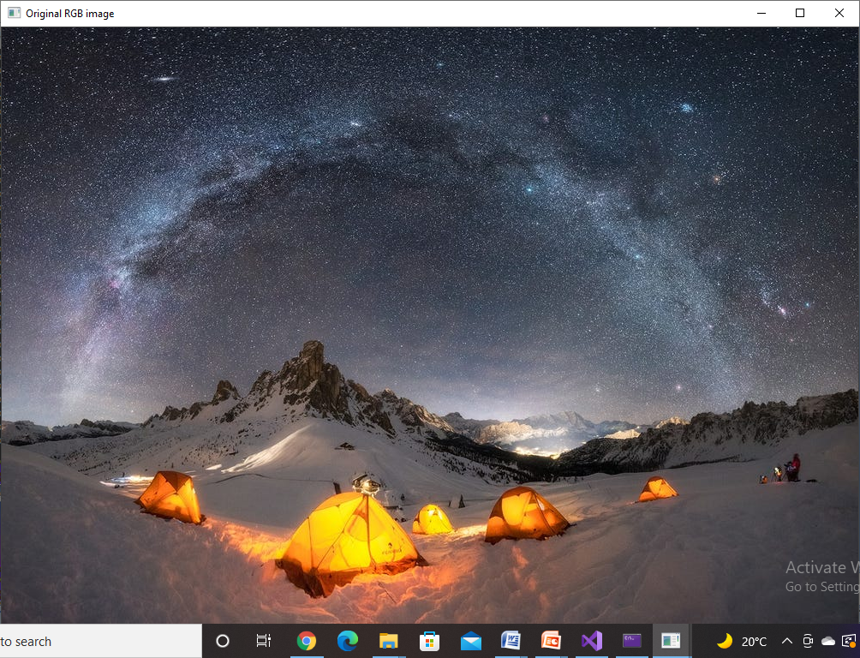

Slide 9
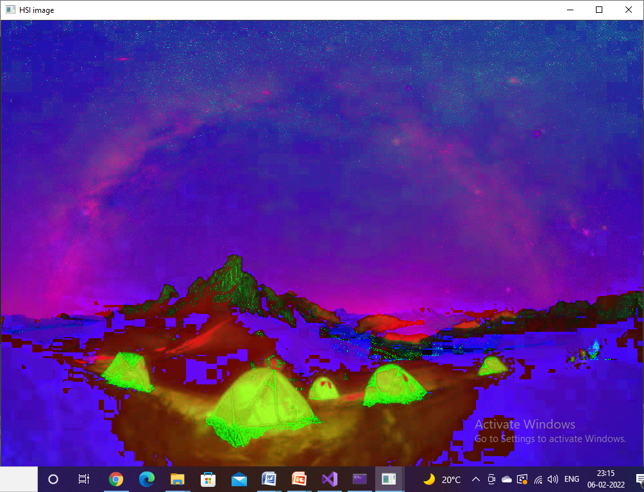

Slide 10
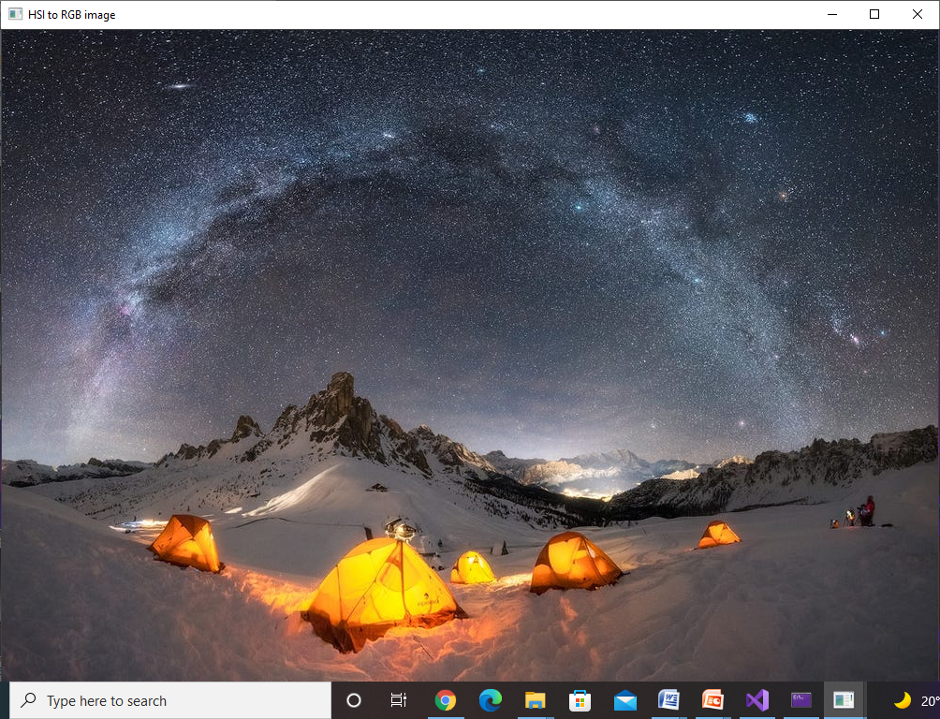

Slide 11
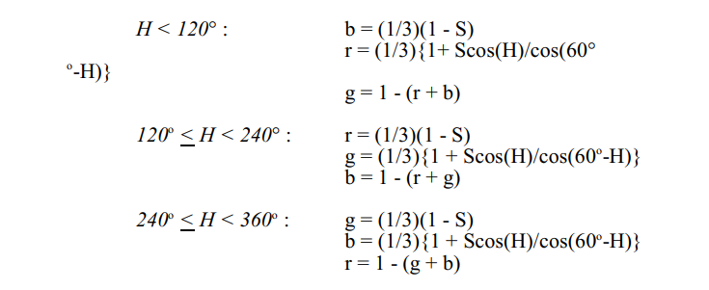

Slide 12
https://www.insider.com/beautiful-milky-way-galaxy-photos-2020-6
The Milky Way galaxy photographed in Dolomites, Italy. Giulio Cobianchi/Capture the Atlas

Slide 13
http://cse.unr.edu

